Slide 1
Alligator PFAS Study: Non-Targeted Analysis
December 2024

Slide 2
Background
5 years (2018-2022), 4 sites (3 NC + 1 FL), ~200 samples
Big Questions
What type and how much PFAS are in alligator plasma?
Absolute quant of up to 26 PFAS
Output: ng/ml PFAS in plasma
Target screening of ~100 PFAS in library
Output: detect yes/no
Output: relative abundance
Non-targeted analysis to find additional PFAS in plasma
Can we fingerprint year and site using PFAS in alligator plasma?
Input: ng/ml PFAS in plasma (Sum26 PFAS and sum6 regulated PFAS)
Input: relative abundance (if detected in enough individuals for each group)
Input: detection frequency of each PFAS
Are any PFAS associated with health endpoints for the alligators?

Slide 3

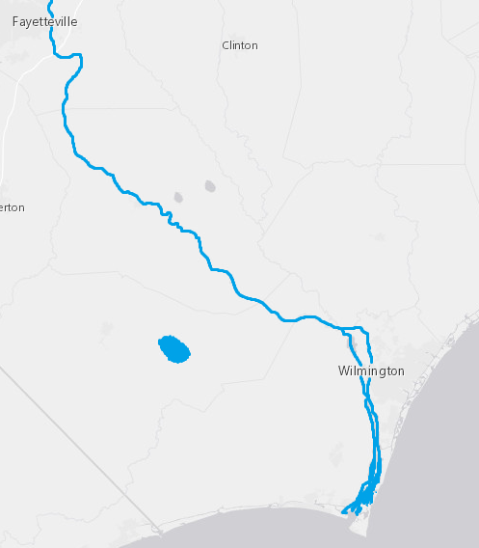

Experimental Design
Extract 200 plasma samples along with blanks, QCs, calibration curve (Completed March 2023)
Analyze using ESI(-) LC-IMS-MS
Analyze a subset using CID-MS in (-) and (+)
Perform target screening for 100 PFAS using in-house library and Skyline
Quantify up to 26 PFAS using cal curves in Skyline
Identify non-target suspect PFAS using IM-MS Browser, Mass Profiler, Fluoromatch, and Greg’s proprietary new tool
A
Lake Waccamaw
B
Cape Fear River
#C2FFE0
C
Coastal NC
A
#006600
B
D
Florida
C
#CC9900
D
#800080

Slide 4
Methods
Generate feature list in Agilent Mass Profiler
Sites B and C vs method blanks (all 12)
Sites B and C vs site A (12 random samples)
MSMS data from sites B and C vs blanks
Prioritized these for more data reduction and higher confidence IDs
Once features are identified, go back and look for them in the MS1 only files
Score features using Fluoromatch-IM
Reduce data and prioritize features using Greg’s tool
Investigate features -> did we find any new PFAS?

Slide 5
Results – Files with MSMS available, BC vs blanks
Focused on gators from sites B and C for NTA, based on target screening data showing highest levels at these sites
Mass Profiler: 2,810 features
Blank subtracted samples by subtracting feature intensities by the mean intensity in the method blank * 3 standard deviations; removed all features with ≤ 0 intensity
After FM-IM and PIMMS: 172 features
Sample ID | Season | Location | Sex
1531 | 2018 | B | F
1602 | 2019 | B | M
1638 | 2019 | B | M
1645 | 2019 | B | F
2106 | 2020 | B | M
2286 | 2022 | C | F
2298 | 2022 | C | M
Sample | Likely | Tentative (EPA library match) | Tentative (No library match) | Total
1531-91 | 12 | 5 | 20 | 37
1602-91 | 9 | 5 | 8 | 22
1638-91 | 9 | 2 | 11 | 22
1645-91 | 13 | 5 | 16 | 34
2018B-91 | 14 | 6 | 11 | 31
2019B-91 | 12 | 10 | 21 | 43
2019C-91 | 10 | 1 | 16 | 27
2020B-91 | 7 | 7 | 19 | 33
2021B-91 | 9 | 6 | 29 | 44
2022B-91 | 9 | 6 | 21 | 36
2022C-91 | 12 | 2 | 18 | 32
2106-91 | 14 | 4 | 12 | 30
2286-91 | 9 | 2 | 9 | 20
2298-91 | 10 | 6 | 11 | 27
Site B | Likely | Tentative (EPA library match) | Tentative (No library match) | Total
1531-91 | 12 | 5 | 20 | 37
1602-91 | 9 | 5 | 8 | 22
1638-91 | 9 | 2 | 11 | 22
1645-91 | 13 | 5 | 16 | 34
2106-91 | 14 | 4 | 12 | 30
2018B-91 | 14 | 6 | 11 | 31
2019B-91 | 12 | 10 | 21 | 43
2020B-91 | 7 | 7 | 19 | 33
2021B-91 | 9 | 6 | 29 | 44
2022B-91 | 9 | 6 | 21 | 36
Site C | Likely | Tentative (EPA library match) | Tentative (No library match) | Total
2286-91 | 9 | 2 | 9 | 20
2298-91 | 10 | 6 | 11 | 27
2019C-91 | 10 | 1 | 16 | 27
2022C-91 | 12 | 2 | 18 | 32

Slide 6
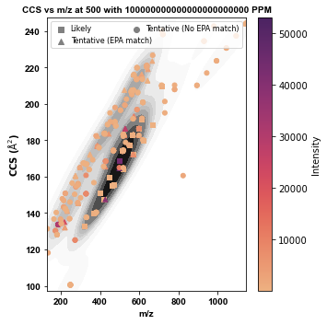
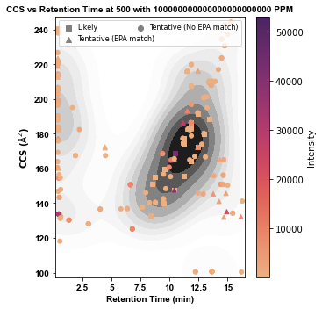
Results – All features after PIMMS

Slide 7
Results – More data reduction
Starting list after PIMMS
Removed all features with RT < 2 min
Likely | Tentative | No match
27 | 24 | 71
Header | Likely | Tentative (EPA library match) | Tentative (No library match)
1531-91 | 12 | 5 | 20
1602-91 | 9 | 5 | 8
1638-91 | 9 | 2 | 11
1645-91 | 13 | 5 | 16
2018B-91 | 14 | 6 | 11
2019B-91 | 12 | 10 | 21
2019C-91 | 10 | 1 | 16
2020B-91 | 7 | 7 | 19
2021B-91 | 9 | 6 | 29
2022B-91 | 9 | 6 | 21
2022C-91 | 12 | 2 | 18
2106-91 | 14 | 4 | 12
2286-91 | 9 | 2 | 9
2298-91 | 10 | 6 | 11
Manually cross referenced Baker lab library and removed duplicates from tentative lists
Likely | Tentative | No match
27 | 17 | 50
67 prioritized features (tentative and no match) to investigate

Slide 8
Results – FM-IM observations
Score | SeriesType_Identifier | Name_or_Class | m/z | Retention Time | row.ID | DT | CCS | Abundance
A | [CF2]n_6 | PFOS-L|(M-H)-|NA|CAS=NA | 498.9302 | 10.45 | 3 | 22.687 | 168.83 | 52951.999
A | [CF2]n_12 | PFOS-L|(M-H)-|NA|CAS=NA | 498.9302 | 10.45 | 3 | 22.687 | 168.83 | 47854.999
A | [CF2]n_5 | PFOS-L|(M-H)-|NA|CAS=NA | 498.9302 | 10.45 | 3 | 22.687 | 168.83 | 43255.999
A | [CF2]n_13 | PFOS-L|(M-H)-|NA|CAS=NA | 498.9302 | 10.45 | 3 | 22.687 | 168.83 | 52869.999
A | [CF2]n_8 | PFOS-L|(M-H)-|NA|CAS=NA | 498.9302 | 10.45 | 3 | 22.687 | 168.83 | 52437.999
A | [CF2]n_7 | PFOS-L|(M-H)-|NA|CAS=NA | 498.9302 | 10.45 | 3 | 22.687 | 168.83 | 52468.999
A | [CF2]n_7 | PFOS-L|(M-H)-|NA|CAS=NA | 498.9302 | 10.45 | 3 | 22.687 | 168.83 | 49764.999
A | [CF2]n_10 | PFOS-L|(M-H)-|NA|CAS=NA | 498.9302 | 10.45 | 3 | 22.687 | 168.83 | 52348.999
A | [CF2]n_8 | PFOS-L|(M-H)-|NA|CAS=NA | 498.9302 | 10.45 | 3 | 22.687 | 168.83 | 52431.999
A | [CF2]n_7 | PFOS-L|(M-H)-|NA|CAS=NA | 498.9302 | 10.45 | 3 | 22.687 | 168.83 | 52353.999
A | [CF2]n_9 | PFOS-L|(M-H)-|NA|CAS=NA | 498.9302 | 10.45 | 3 | 22.687 | 168.83 | 52517.999
PFOS-L (feature ID 3) is placed in 8 different homologous series across the set of 11 samples

Slide 9
Results – Checking PIMMS in Skyline
Input features into Skyline to quickly check multiple samples at once
Of the 67 features, some were post source decay of multimers of known PFAS – removed from list
Many of them were noise (signal throughout LC gradient) or contamination (peak present in double blank)
15 features remained

Slide 10
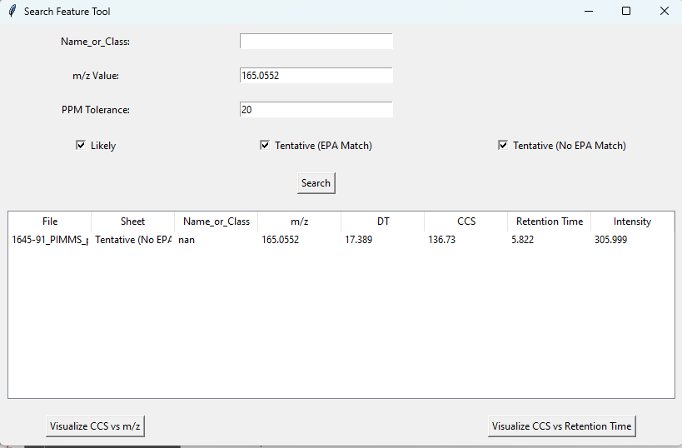
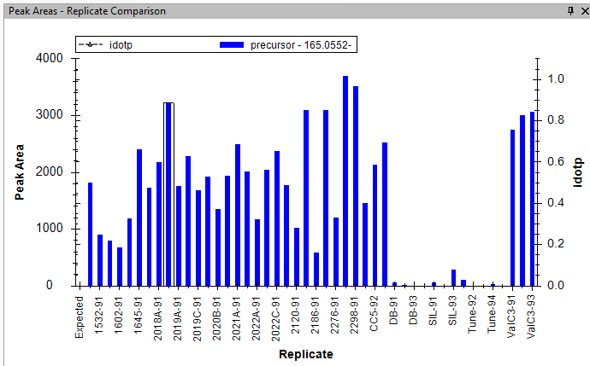
Results – observation of PIMMS vs Skyline
Feature ID 2288, m/z 165.0552
PIMMS says only in sample ID 1645
Skyline says present in all gator samples

Slide 11
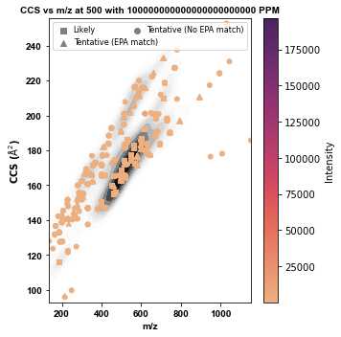
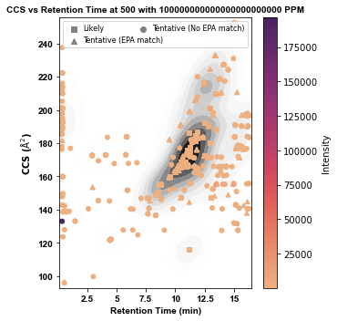
Doesn’t look like anything… back to MS1 data
Sites B and C as experiment, Site A as control for feature prioritization
MP results: 8,958 features
After PIMMS processing: 242 features
31 likely
62 tentative (EPA match)
149 tentative (no EPA match)

Slide 12
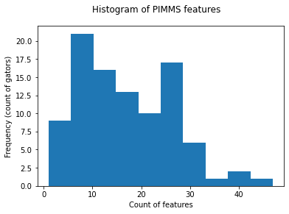
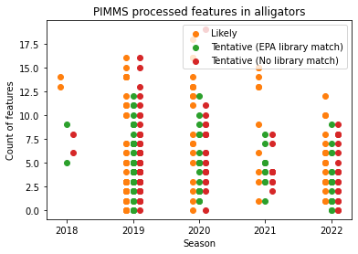
PIMMS output (without any feature validation)
Mean: 16.8 features/gator, SD 9.8
Median: 15.5 features/gator
Min: 1 feature/gator
Max: 47 features/gator

Slide 13
Breakdown
Site Averages (features/gator)
Total
B 18.5
C 12.0
Likely
B 7.7
C 4.4
Tentative (EPA match)
B 5.0
C 3.4
Tentative (no match)
B 5.8
C 4.2
Site B Averages (Total features/gator)
Season
2018 27.5
2019 17.0
2020 20.7
2021 18.1
2022 17.8
Site B Averages (Total features/gator)
Sex
F 20.3
M 17.6
Site C Averages (Total features/gator)
Season
2019 12.9
2022 11.3
Site C Averages (Total features/gator)
Sex
F 9.3
M 13.3

Slide 14
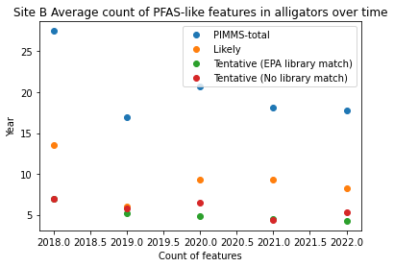
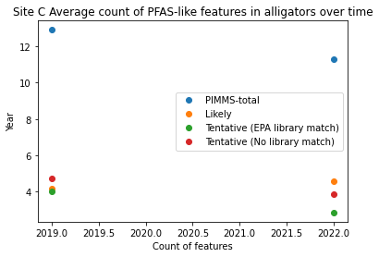
Unvalidated PFAS-like features conclusions
More PFAS-like features at site B
No clear trends over time

Slide 15
Validation of features flagged by PIMMS

Slide 16
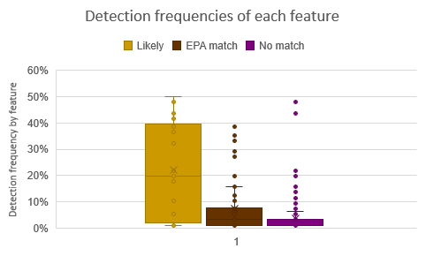
Goals with validation and annotation
Aim of project was using gators as a sentinel species for PFAS exposure
What PFAS are in the gators that should be monitored for in water, fish, and people?
Spreadsheet "C:\Users\Student PC\OneDrive - University of North Carolina at Chapel Hill\UNC Research\2022 Alligator Plasma PFAS\PIMMS\AKB_feature_summary_prioritized_20241204.xlsx“
Prior to validation, all tentative features are Level 5 (62 EPA match + 149 with no match = 211 Level 5 features)

Slide 17
“Likely” Feature Validation
FM-IM uses a pre-loaded CCS library (based on ours)
PIMMS looks for m/z and CCS matches from FM-IM (score = A) and assigns a “Likely” name
Neither of these check against in-house values for RT -> required for a higher confidence identification
Without validation, default is Level 3 for these 31 features
However, Skyline workflow should already catch these features
Goals:
See if we can find any new PFAS that are isobars of library PFAS
Investigate how well PIMMS compares to Skyline in alligators

Slide 18
“Likely” features flagged in PIMMS
31 features matched to 14 different PFAS
6 PFCAs
PFNA, PFDA, PFUdA, PFDoA, PFTrDA, PFTeDA
Can have both M-H- and M-H-CO2-, explains some of the duplicates
5 PFSAs
PFHxS, PFHpS, PFOS, PFNS, PFDS
Library contains L-PFSAs only, so branched isomers are flagged as linear
3 others
8:2 FTS
Nafion Byproduct 2
Interestingly, 4 features with 3 RT peaks
PMPA

Slide 19
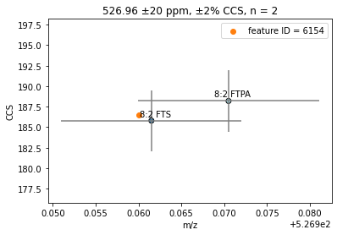
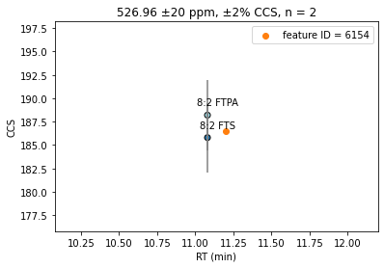
“Likely” feature RT checking vs our library
Example of a confirmed match: 8:2 FTS
Level 1 based on in-house library RT, CCS, and m/z match plus diagnostic evidence (6:2 FTS and 10:2 FTS also detected in Skyline workflow)

Slide 20
“Likely” feature RT checking vs our library: Erroneous matches
Nafion Byproduct 2 (504, 1086, 2376, 3273)
RT peaks (8.64, 8.71, 8.78) are seen as 2 peaks in Skyline (8.6 and 8.8 min)
In house library is 8.8 min
Skyline also has 2 other peaks (9.2 and 9.4 min) in some samples
Confirmed the 8.6 and 8.8 min peaks are NBP2 (branched isomers)
8.8 min: Level 1
8.6 min: Level 3
Peaks at 9.2 and 9.4 min could be false negatives in PIMMS or false positives in Skyline (Level 3 or 4?)
PFNA (8367, 330, 3331)
2 peaks at 10.4 min (matches in house library) – these are confirmed Level 1
1 peak at 13.2 min with correct CCS for PFNA M-H-CO2-
Skyline shows several other RTs with this peak – suggests in source fragment of something else
Several structural possibilities at the same RT could generate a C₈F₁₇ in source: heavy N-EtFOSE, heavy N-EtFOSA, 6:8 PFPi)

Slide 21
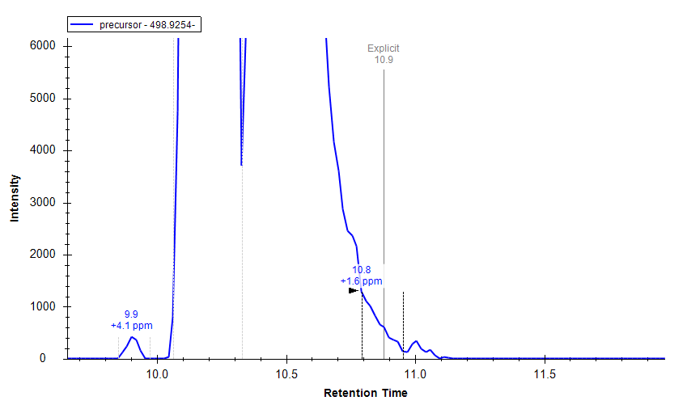
“Likely” feature RT checking vs our library: Erroneous matches continued
PFOS (5002) at 10.9 min
If this is a new PFAS, there’s no way to tell
More likely just a long tailing PFOS
Flagged as novel due to no tail in the blanks
False positive
PFUdA (595, 2130, 377, 747)
PIMMS has 3 RT peaks (11.7, 11.8, 11.9 min) and 2 CCS peaks
Skyline has 2 RT peaks: 11.7 and 11.9 min
Library has 1 RT peak (11.9 min) and 2 CCS peaks (for M-H- and M-H-CO2-)
595 and 377: confirmed PFUdA
2130 and 747: br-PFUdA?
PMPA (1413)
RT of 11.1 min, which does not match our library RT value of 2.6 min
Skyline also shows a peak at 7.3 min
More likely in source C₃F₇O fragment (heavy or native GenX at 7.3 min)
Possibly indicating some other ether is eluting here (none in our library at a similar RT) – worth investigating more

Slide 22
“Tentative” PFAS Prioritization
Excluded features with RT < 2 min
EPA match: 6 features
No match: 34 features
Imported list to Skyline to check if noise/present in blanks
Investigated remaining features
Prioritized by highest detection frequency
Compared to MSMS list

Slide 23
Imported tentative matches into Skyline
Many of the features were clearly spurious despite being identified in feature finding, FM-IM, and PIMMS filtering
Excluded due to:
Duplicate of a branched PFSA isomer (PFOS, PFNS, PFDS) -9 features
Noise present throughout chromatogram -110 features
Tailing from another feature in m/z or drift dimension -2 features
Present in high levels in blanks -22 features
Prioritized “tentative” features remaining:
EPA library match: 13
No match: 15
Compared prioritized matches to MSMS priority list -> interestingly, no matches
Could mean no MS2 data available for MS1 priority features? Not necessarily..
Compared priority list to in-house library as a double check
EPA library matches: 6 of them were post-source decay of a PFCA already in the library
No match: 9 PSD

Slide 24
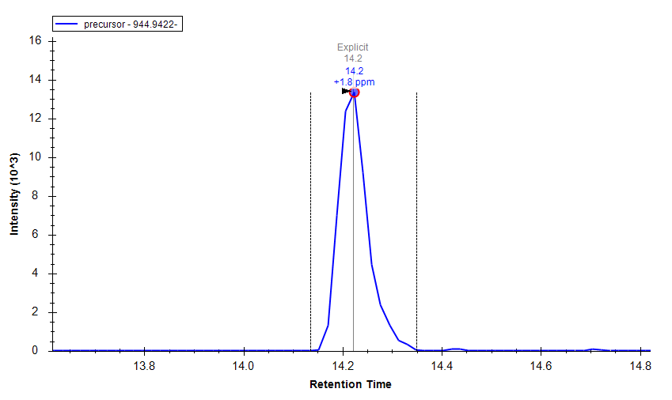
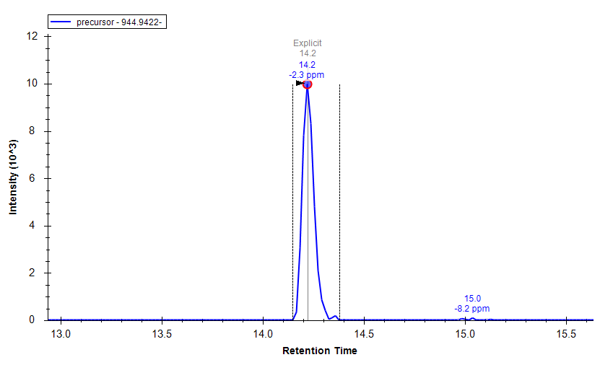
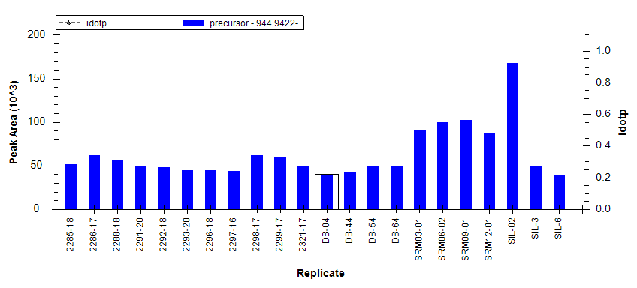
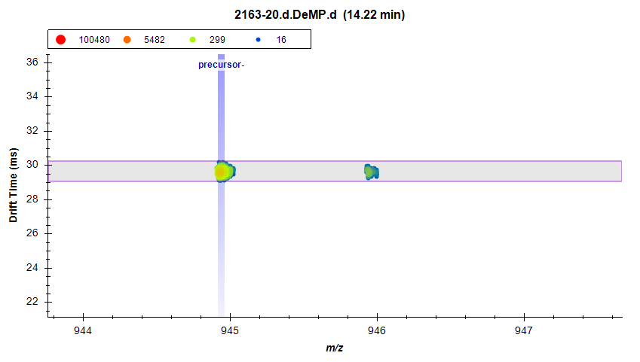
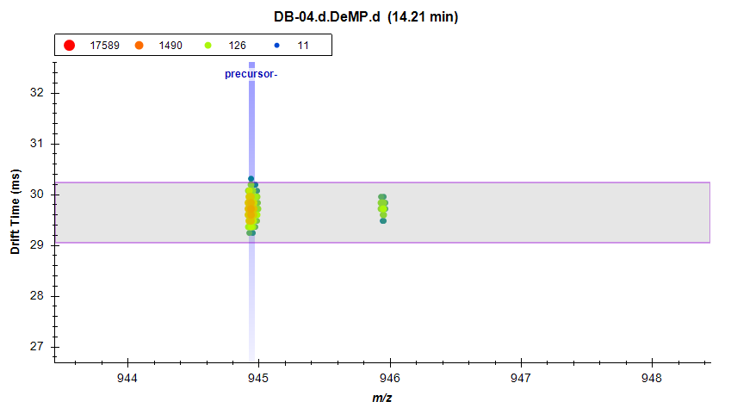
Example: Excluded (present in blanks)
Gator sample
Double blank
Feature ID# 393
PIMMS: Tentative (No library match)
FM-IM: 3+ in RT and DT ordered homologous series
Interestingly, detection frequency with PIMMS was 1.0%
Illustrates complexity of blank subtraction
Suggestion/explore: Use a stricter blank subtraction (e.g. 10x average of blanks)

Slide 25
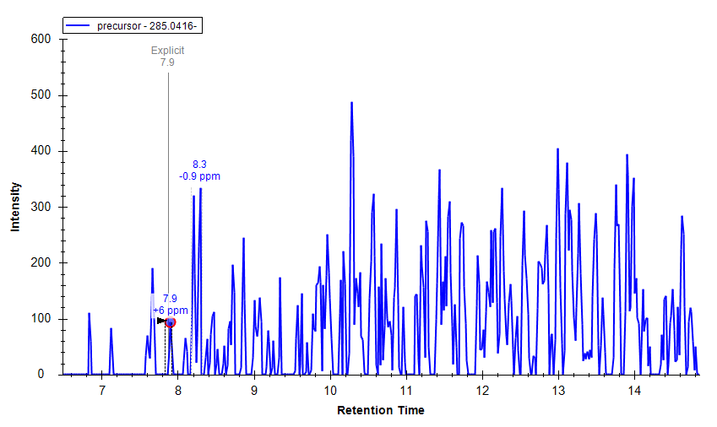
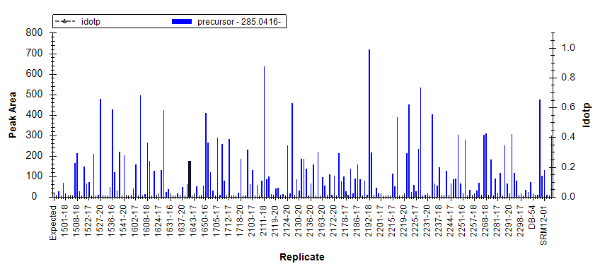
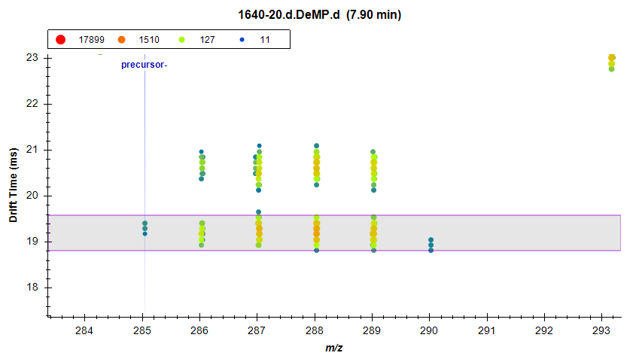
Example: Excluded (noise)
Feature ID# 8778
PIMMS: Tentative (EPA library match)
(1z,6z)-2,2,3,3,4,4,5,5-octafluorohexanediimidamide
FM-IM: Mass defect falling within -0.11 and 0.12 OR exact mass match, and 3+ within homologous series
Detection frequency with PIMMS: 1.0%

Slide 26
Validation of prioritized “tentative” features
Prioritized “tentative” features remaining:
EPA library match: 13
No match: 15
Compared prioritized matches to MSMS priority list -> interestingly, no matches
Could mean no MS2 data available for MS1 priority features? Not necessarily..
Compared priority list to in-house library as a double check
EPA library matches: 6 of them were post-source decay of a PFCA already in the library
No match: 9 PSD

Slide 27
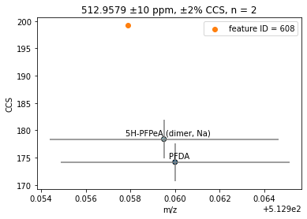
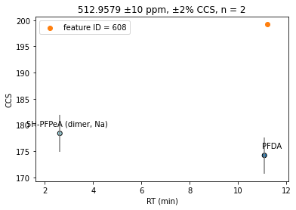
Example: Post-source decay of something else

Slide 28
Features that might actually be PFAS
3 “Likely” matches that didn’t line up with in house library values
2130: matched PFUdA M-H- but lower RT (possible branched isomer)
747: matched PFUdA M-H-COO- but lower RT (possible branched isomer)
1413: matched PMPA but wrong RT – possible in source fragment of an ether
7 EPA library matches
1692: matched PFEESA in the EPA library, but has a different RT than our PFEESA entry
4751: matched PFECHS in the EPA library, but different CCS than our PFECHS entry
7712: matched a br-PFOA in the EPA library, likely PFOA M-H- (not in our library)
2318: matched PubChem CID 22568764 (C8HF17O₄S, ether sulfonate)
6811
2216
5135
5 features with no library match
5849: in series with PFCA M-H-COO-, possibly PFPeDA
2857: in series with the other PFESAs (1692 and 2318)
3511
1159
331

Slide 29
Features that might actually be PFAS
3 “Likely” matches that didn’t line up with in house library values
2130: matched PFUdA M-H- but lower RT (possible branched isomer)
747: matched PFUdA M-H-COO- but lower RT (possible branched isomer)
1413: matched PMPA but wrong RT – possible in source fragment of an ether
7 EPA library matches
1692: matched PFEESA in the EPA library, but has a different RT than our PFEESA entry
4751: matched PFECHS in the EPA library, but different CCS than our PFECHS entry
7712: matched a br-PFOA in the EPA library, likely PFOA M-H- (not in our library)
2318: matched PubChem CID 22568764 (C8HF17O₄S, ether sulfonate)
6811
2216
5135
5 features with no library match
5849: in series with PFCA M-H-COO-, possibly PFPeDA
2857: in series with the other PFESAs (1692 and 2318)
3511
1159
331

Slide 30
Long chain PFESAs detected in alligators
Detected in gators
Detected in SPATTs
Reference standard value in our library
PFHxESA (Feature ID# 2318)
Confidence Level: 2
Molecular Formula: C₈HF₁₇O₄S
[M-H]-: 514.925131 Da
PFHpESA (Feature ID# 2857)
Confidence Level: 2
Molecular Formula: C₉HF₁₉O₄S
[M-H]-: 564.921938 Da
Feature ID# 1692
Unidentified. Exact m/z match to PFEESA but wrong RT and wrong CCS

Slide 31
Features that might actually be PFAS
3 “Likely” matches that didn’t line up with in house library values
2130: matched PFUdA M-H- but lower RT (possible branched isomer)
747: matched PFUdA M-H-COO- but lower RT (possible branched isomer)
1413: matched PMPA but wrong RT – possible in source fragment of an ether
7 EPA library matches
1692: matched PFEESA in the EPA library, but has a different RT than our PFEESA entry – Level 5
4751: matched PFECHS in the EPA library, but different CCS than our PFECHS entry
7712: matched a br-PFOA in the EPA library, likely PFOA M-H- (not in our library)
2318: matched PubChem CID 22568764 (C8HF17O₄S, ether sulfonate). – Level 2
6811
2216
5135
5 features with no library match
5849: in series with PFCA M-H-COO-, possibly PFPeDA
2857: in series with the other PFESAs (1692 and 2318) – Level 2
3511
1159
331

Slide 32
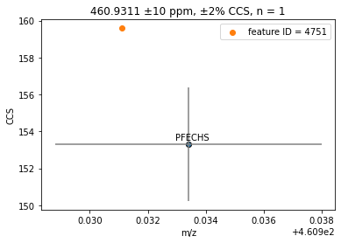
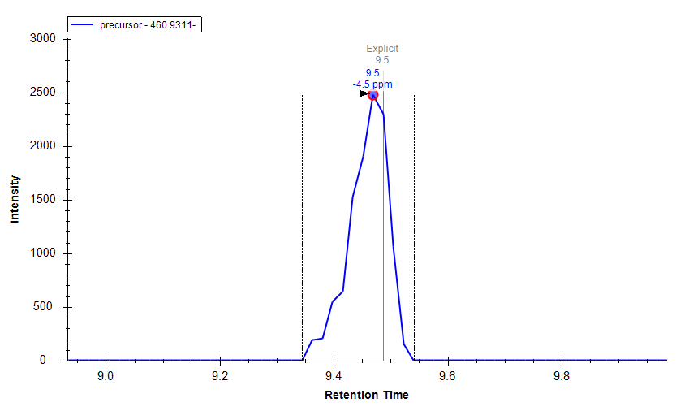
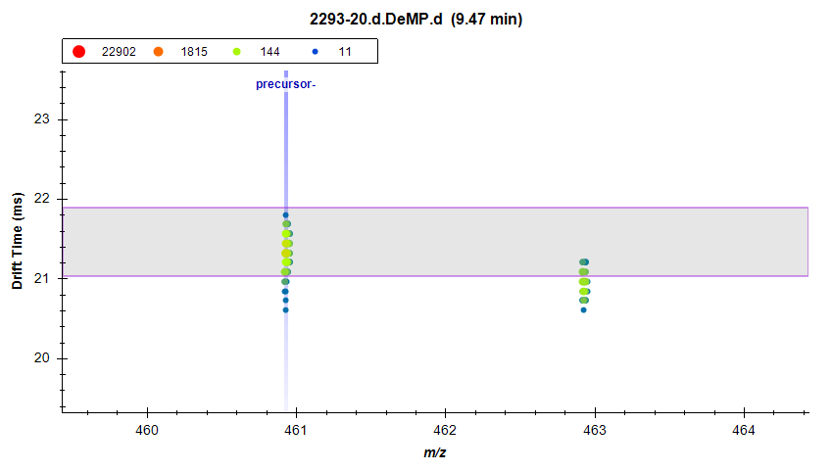
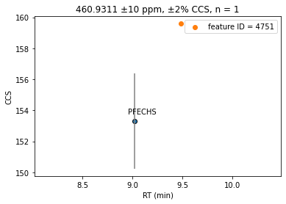
U-PFOS
U-PFOS and PFECHS have the same formula (C8HF15O3S)
Feature 4751 has a different CCS than PFECHS – clearly it is not PFECHS
RT is also a bit different from in-house library RT for PFECHS
U-PFOS has been reported in literature (and SPATTs)
Multiple overlapping RT and DT peaks for this feature
MS2
PFECHS expected to have a 380.97 fragment
U-PFOS expected to have unsaturated fragments C3F5 (130.99), C4F7 (180.99), etc.
Signal not high enough to see any discernable fragments
Conclusion: U-PFOS, Confidence Level: 3

Slide 33
Features that might actually be PFAS
3 “Likely” matches that didn’t line up with in house library values
2130: matched PFUdA M-H- but lower RT (possible branched isomer)
747: matched PFUdA M-H-COO- but lower RT (possible branched isomer)
1413: matched PMPA but wrong RT – possible in source fragment of an ether
7 EPA library matches
1692: matched PFEESA in the EPA library, but has a different RT than our PFEESA entry – Level 5
4751: matched PFECHS in the EPA library, but different CCS than our PFECHS entry – Level 3
7712: matched a br-PFOA in the EPA library, likely PFOA M-H- (not in our library)
2318: matched PubChem CID 22568764 (C8HF17O₄S, ether sulfonate). – Level 2
6811
2216
5135
5 features with no library match
5849: in series with PFCA M-H-COO-, possibly PFPeDA
2857: in series with the other PFESAs (1692 and 2318) – Level 2
3511
1159
331

Slide 34
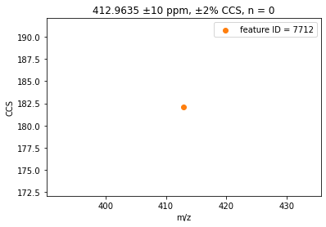
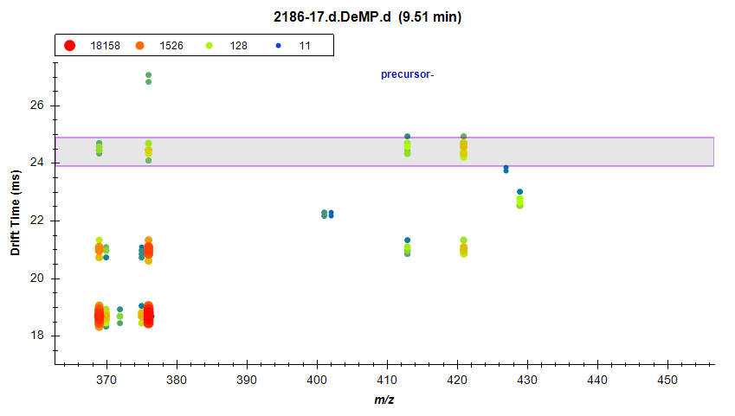
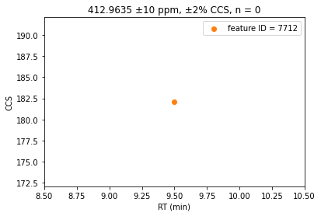
PFOA M-H- post source decay
PFOA M-H- is not in our library currently
Feature exactly matches PFOA M-H- m/z and aligns with our library RT value
PFOA multimer drift window
PFOA M-H- drift window
PFOA M-H-CO₂- drift window
PFOA M-H-CO₂- m/z
PFOA M-H-
m/z
¹³C₈-PFOA M-H-CO₂- m/z
¹³C₈-PFOA M-H-
m/z
Conclusion: duplicate identification of PFOA

Slide 35
Features that might actually be PFAS
3 “Likely” matches that didn’t line up with in house library values
2130: matched PFUdA M-H- but lower RT (possible branched isomer)
747: matched PFUdA M-H-COO- but lower RT (possible branched isomer)
1413: matched PMPA but wrong RT – possible in source fragment of an ether
7 EPA library matches
1692: matched PFEESA in the EPA library, but has a different RT than our PFEESA entry – Level 5
4751: matched PFECHS in the EPA library, but different CCS than our PFECHS entry – Level 3
7712: matched a br-PFOA in the EPA library, likely PFOA M-H- (not in our library) - na
2318: matched PubChem CID 22568764 (C8HF17O₄S, ether sulfonate). – Level 2
6811
2216
5135
5 features with no library match
5849: in series with PFCA M-H-COO-, possibly PFPeDA
2857: in series with the other PFESAs (1692 and 2318) – Level 2
3511
1159
331

Slide 36
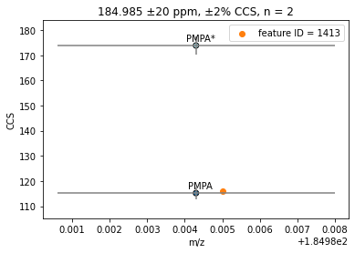
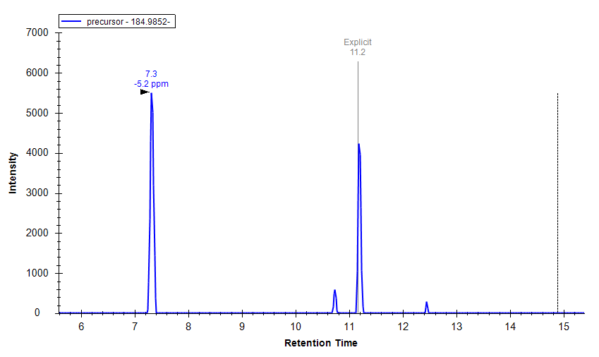
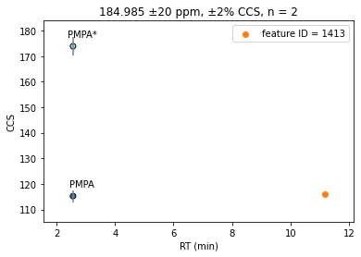
Not PMPA
Feature 1413 (m/z 184.985) matched PMPA in the EPA library
CCS values match almost exactly
RT values are very different (PMPA in library = 2.6 min)
Enough evidence to propose a formula (C3F7O)
However, RT makes no sense
Hypothesis: this is an in source fragment of another ether
HFPO-DA (GenX)
(or SIL)
HFPO-TrA
HFPO-TeA

Slide 37
Not PMPA
None of the native precursors were detected in any sample
Heavy GenX was detected broadly – internal standard spike (likely the peak at 7.3 is from the IS)
Next step: do a correlation analysis of this feature based on location/year, looking at the last 3 peaks only
Hypothesis: expecting to see more peaks in Site B vs Site A, and more in 2018 than in later years
HFPO-DA (GenX)
(or SIL)
No matching PFECAs in our library with this RT
HFPO-TrA
HFPO-TeA

Slide 38
Features that might actually be PFAS
3 “Likely” matches that didn’t line up with in house library values
2130: matched PFUdA M-H- but lower RT (possible branched isomer)
747: matched PFUdA M-H-COO- but lower RT (possible branched isomer)
1413: matched PMPA but wrong RT – possible in source fragment of an ether - TBD
7 EPA library matches
1692: matched PFEESA in the EPA library, but has a different RT than our PFEESA entry – Level 5
4751: matched PFECHS in the EPA library, but different CCS than our PFECHS entry – Level 3
7712: matched a br-PFOA in the EPA library, likely PFOA M-H- (not in our library) - na
2318: matched PubChem CID 22568764 (C8HF17O₄S, ether sulfonate). – Level 2
6811
2216
5135
5 features with no library match
5849: in series with PFCA M-H-COO-, possibly PFPeDA
2857: in series with the other PFESAs (1692 and 2318) – Level 2
3511
1159
331

Slide 39
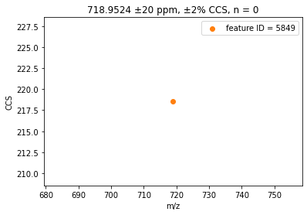
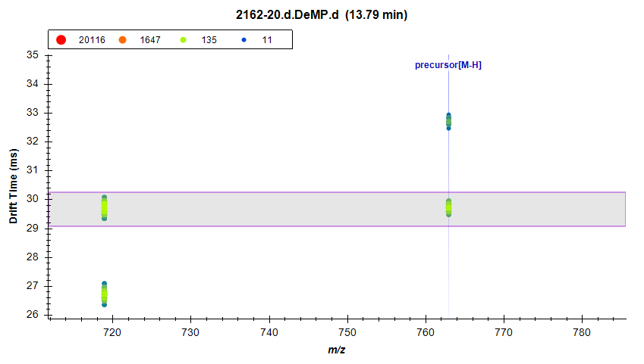
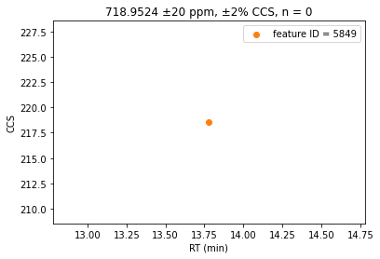
PFPeDA
PFPeDA
M-H- CCS: 218.72
M-H-CO2 CCS: 197
RT: 13.7 min
PFPeDA, Confidence Level 2

Slide 40
Features that might actually be PFAS
3 “Likely” matches that didn’t line up with in house library values
2130: matched PFUdA M-H- but lower RT (possible branched isomer)
747: matched PFUdA M-H-COO- but lower RT (possible branched isomer)
1413: matched PMPA but wrong RT – possible in source fragment of an ether - TBD
7 EPA library matches
1692: matched PFEESA in the EPA library, but has a different RT than our PFEESA entry – Level 5
4751: matched PFECHS in the EPA library, but different CCS than our PFECHS entry – Level 3
7712: matched a br-PFOA in the EPA library, likely PFOA M-H- (not in our library) - na
2318: matched PubChem CID 22568764 (C8HF17O₄S, ether sulfonate). – Level 2
6811: m/z 480.968 (plus 2 isobars at different RTs)
2216: matched formula C11H10F4O4
5135: m/z 448.966, matched formula C8H3F17Si
5 features with no library match
5849: in series with PFCA M-H-COO-, possibly PFPeDA – Level 2
2857: in series with the other PFESAs (1692 and 2318) – Level 2
3511: m/z 207.0420
1159: m/z 229.0550
331: m/z 323.09

Slide 41
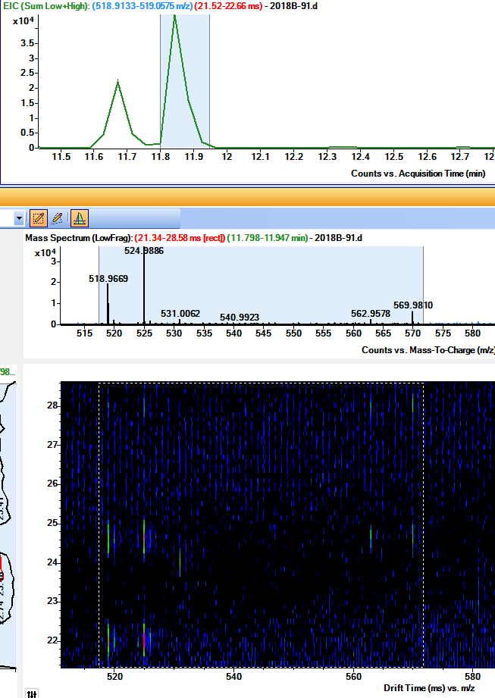
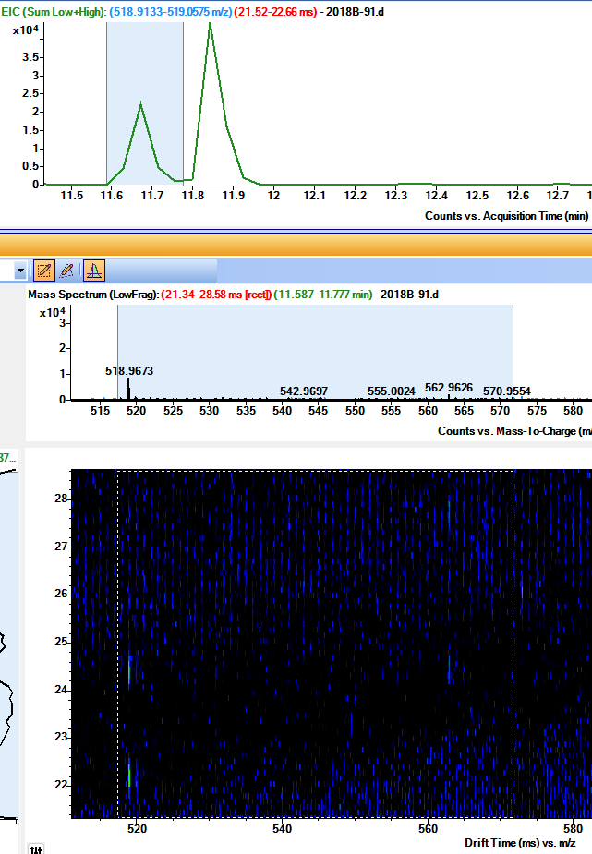
2130 and 747 – PFUdA?
PIMMS matched Likely PFUdA for a signal at 11.7 min
IS signal predominates at 11.9 min
No IS signal at 11.7 min
Conclusion:
Peak at 11.7 is br-PFUdA, confidence level 3
MS2 fragments
M-H-CO2: 168.9931 (C3F7), 118.9934 (C2F5)
MS2 fragments
M-H-CO2: 318.9974 (C6F13), 218.9856 (C4F9), 168.9931 (C3F7), 118.9934 (C2F5)

Slide 42
Features that might actually be PFAS
3 “Likely” matches that didn’t line up with in house library values
2130: matched PFUdA M-H- but lower RT (possible branched isomer) – Level 3
747: matched PFUdA M-H-COO- but lower RT (possible branched isomer) – Level 3
1413: matched PMPA but wrong RT – possible in source fragment of an ether - TBD
7 EPA library matches
1692: matched PFEESA in the EPA library, but has a different RT than our PFEESA entry – Level 5
4751: matched PFECHS in the EPA library, but different CCS than our PFECHS entry – Level 3
7712: matched a br-PFOA in the EPA library, likely PFOA M-H- (not in our library) - na
2318: matched PubChem CID 22568764 (C8HF17O₄S, ether sulfonate). – Level 2
6811: m/z 480.968 (plus 2 isobars at different RTs)
2216: matched formula C11H10F4O4
5135: m/z 448.966, matched formula C8H3F17Si
5 features with no library match
5849: in series with PFCA M-H-COO-, possibly PFPeDA – Level 2
2857: in series with the other PFESAs (1692 and 2318) – Level 2
3511: m/z 207.0420
1159: m/z 229.0550
331: m/z 323.09

Slide 43
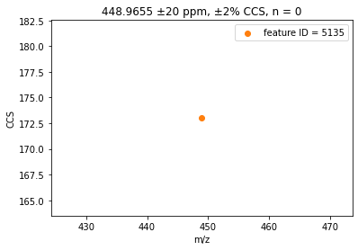
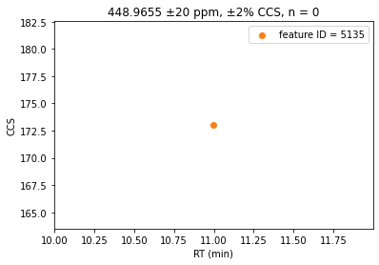
5135 – m/z 448.9655
Drift aligned peak at m/z 592.9495 seen in all of the same peaks and all the same samples
Post source decay of the m/z 592 feature, or its own thing?
448.9655 + CO₂C₂F₄ = 592.9495
PIMMS matched EPA library for (Heptadecafluorooctyl)silane C8H3F17Si – seems unlikely
No Baker library matches

Slide 44
Other possible structures for m/z 592.9481
Backbone of compounds 9 & 10. Kaylie’s paper suggested the H-substitution for the carboxylic acid group is plausible and reported elsewhere
Identification: H-substituted perfluoro triether carboxylic acid
Confidence level: 3
Novel PFAS
m/z 282.9822
m/z 262.9760

Slide 45
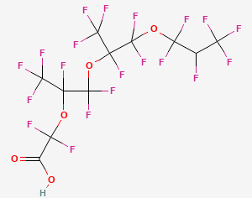
Other possible structure for m/z 592.9495
448.9655 + CO₂C₂F₄ = 592.9495 <- Evidence: These are drift aligned and RT aligned. Could suggest that 592 has a carboxylic acid group attached to a C₂F₄
Observed fragments:
262.9755 = C5F9O2
212.9787 = C4F7O2
184.9837 = C3F7O2
168.9888 = C3F7
118.9920 = C2F5
79.9593 = SO3 (however – this feature coelutes with PFNS and is close in drift time, so there might not necessarily be an SO3 here)
Possible formula for 448.9655: C5F9O2 + C3F7O + H
Multiple RT peaks suggests multiple branched forms
Possible molecular formula: C11H2F20O5
Exactly one PubChem CID (163325041) matches formula but structure doesn’t line up with a CO₂(CF₂)₂ loss
Identification: H-substituted perfluoro triether carboxylic acid
Confidence level: 3
Novel PFAS
m/z 448.9655

Slide 46
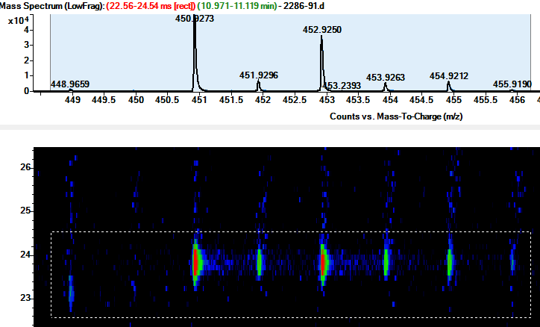
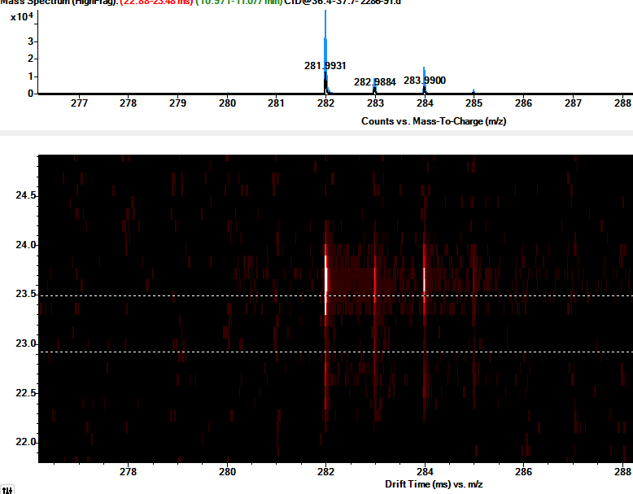
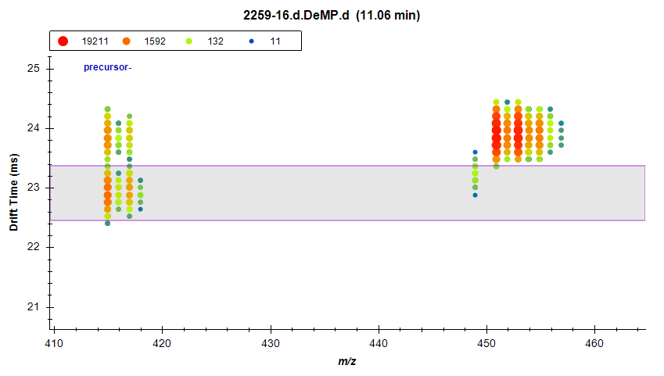
m/z 450.9280 and 414.9492
Nested spectra for peak at 11.0 min (m/z 450.9273, not seen at lower RTs)
Also seeing feature at m/z 414.9492 eluting at 11.0 min only and close but not quite drift aligned with both 448 and 450!
What is going on here?!
For now – considering a likely in-source decay product of m/z 592.9481, formula TBD
Drift pattern suggests carboxylic acid (in source dimer)

Slide 47
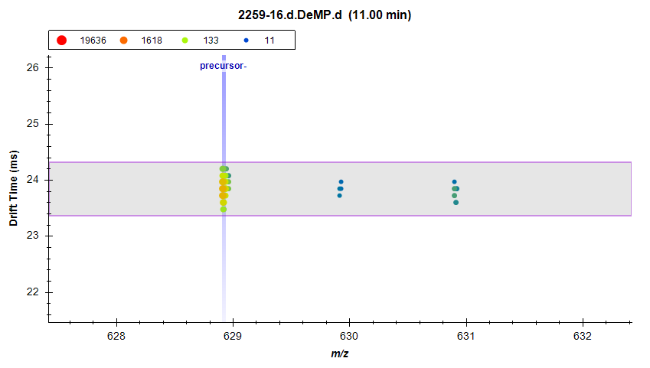
m/z 628.9189
Kaylie’s compound 10 with loss of a COOH
Compound 10 not detected in gators
No Pubchem entries match this formula – novel PFAS
Perfluorinated ether sulfonic acid
C10H2F20O6S M-H-
Confidence level: 3
Kaylie’s compound 10 with loss of a COOH
Compound 10 not detected
Other possible structural isomer
Fragments: 262.9749

Slide 48
Conclusions from feature ID 5135
PIMMS flagged one feature (m/z 448.966) as matching formula C8H3F17Si on the EPA list
Manual validation confirmed a different formula (C8HF16O3)
Calling this a Level 3 even though it might be an in source fragment of m/z 592.9495
Further investigation found 4 additional features
m/z 592.9495 – tentative structure proposed
m/z 628.9189 – tentative structure proposed
m/z 450.9280 – no formula yet, likely in source fragment of m/z 592.9495
m/z 414.9492 – no formula yet, likely in source fragment of m/z 592.9495
One feature flagged resulted in…
3 features ID’ed to Confidence Level 3 (all novel)
2 features ID’ed to Confidence Level 5

Slide 49
Features that might actually be PFAS
3 “Likely” matches that didn’t line up with in house library values
2130: matched PFUdA M-H- but lower RT (possible branched isomer) – Level 3
747: matched PFUdA M-H-COO- but lower RT (possible branched isomer) – Level 3
1413: matched PMPA but wrong RT – possible in source fragment of an ether - TBD
7 EPA library matches
1692: matched PFEESA in the EPA library, but has a different RT than our PFEESA entry – Level 5
4751: matched PFECHS in the EPA library, but different CCS than our PFECHS entry – Level 3
7712: matched a br-PFOA in the EPA library, likely PFOA M-H- (not in our library) - na
2318: matched PubChem CID 22568764 (C8HF17O₄S, ether sulfonate). – Level 2
6811: m/z 480.968 (plus 2 isobars at different RTs)
2216: matched formula C11H10F4O4
5135: m/z 448.966, matched formula C8H3F17Si – 3 Level 3s, 2 Level 5s
5 features with no library match
5849: in series with PFCA M-H-COO-, possibly PFPeDA – Level 2
2857: in series with the other PFESAs (1692 and 2318) – Level 2
3511: m/z 207.0420
1159: m/z 229.0550
331: m/z 323.09

Slide 50
6811 – m/z 480.9680
PIMMS found m/z 480.9680 (EPA match to formula C12H2F16O2) , CCS 165.79, RT 10.54
While validating features, found it to be present in blanks
Conclusion: contamination
However, looking in Skyline, there appeared to be a tailing peak from the PIMMS feature at a slightly lower m/z that was appearing at 2 different RTs
m/z 480.937
10.2 min, CCS 165.4
9.7 min, CCS 159.5
Exact mass matches formula C8HF16O3S (1H-substituted PFOS)
Fragmentation spectra show SO3 and SO3F fragments
However, drift and RT overlaps with PFOS-br so these are not diagnostic
Abundance is too low to get meaningful fragments
Conclusion: Confidence Level 5

Slide 51
Features that might actually be PFAS
3 “Likely” matches that didn’t line up with in house library values
2130: matched PFUdA M-H- but lower RT (possible branched isomer) – Level 3
747: matched PFUdA M-H-COO- but lower RT (possible branched isomer) – Level 3
1413: matched PMPA but wrong RT – possible in source fragment of an ether - TBD
7 EPA library matches
1692: matched PFEESA in the EPA library, but has a different RT than our PFEESA entry – Level 5
4751: matched PFECHS in the EPA library, but different CCS than our PFECHS entry – Level 3
7712: matched a br-PFOA in the EPA library, likely PFOA M-H- (not in our library) - na
2318: matched PubChem CID 22568764 (C8HF17O₄S, ether sulfonate). – Level 2
6811: m/z 480.968 (plus 2 isobars at different RTs) – 2 Level 5s
2216: matched formula C11H10F4O4
5135: m/z 448.966, matched formula C8H3F17Si – 3 Level 3s, 2 Level 5s
5 features with no library match
5849: in series with PFCA M-H-COO-, possibly PFPeDA – Level 2
2857: in series with the other PFESAs (1692 and 2318) – Level 2
3511: m/z 207.0420
1159: m/z 229.0550
331: m/z 323.09

Slide 52
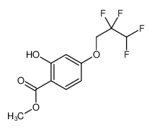
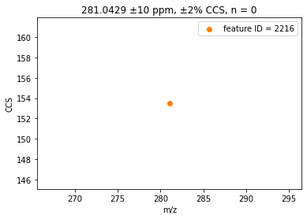
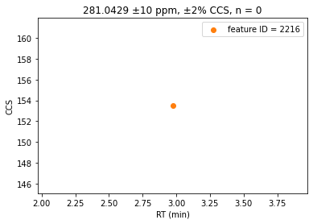
2216: m/z 281.0429
EPA library match to C11H10F4O4
Fragments: 237.0565
Low signal though and very low precursor signal

Slide 53



Slide 54



Slide 55



Slide 56
Conclusions from feature validation

Slide 57
What does it all mean?

Slide 58
Back to Skyline
Relative abundance comparisons of all features in our library and those ID’ed with PIMMS
Group by: absolute quant, other Level 1, Level 2, Level 3, Level 4, Level 5
Unique aspect of IMS+PFAS is greater likelihood that Level 4 and 5 features are actually the same features across samples

Slide 59
Overall conclusions

Slide 60
Future directions
Adding dimers and post-source decay to library will help reduce false positives with less manual validation
Try different sample prep protocols (add formic acid) to see if it boosts signal – could improve MS2 fragmentation spectra
Monitor these PFAS in people from this area

